Slide 1
AWS Cloud Fundamentals
Kerry Nakayama

Slide 2
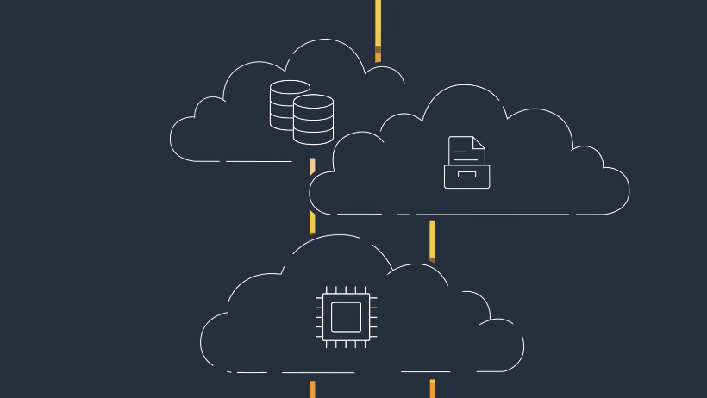
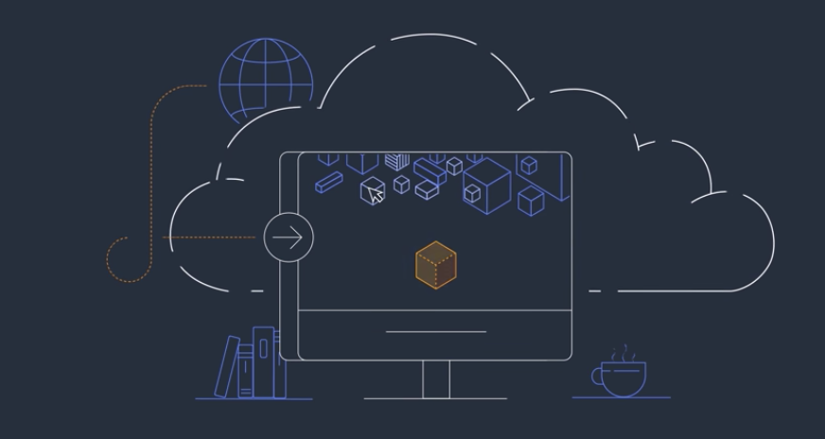
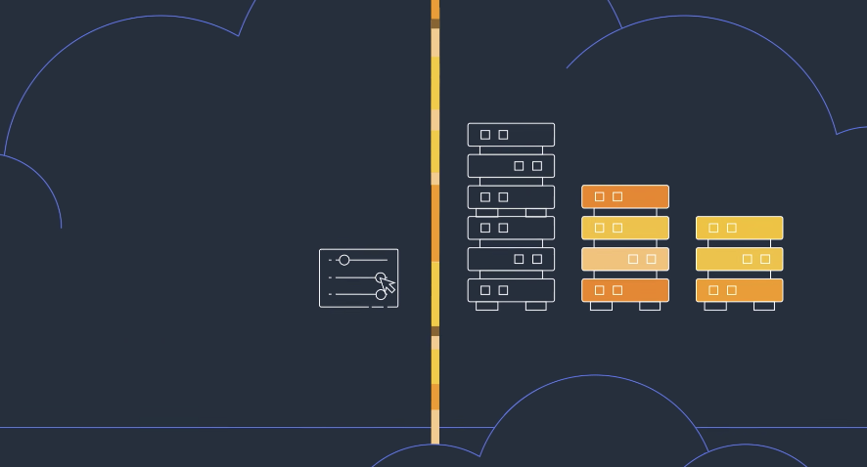
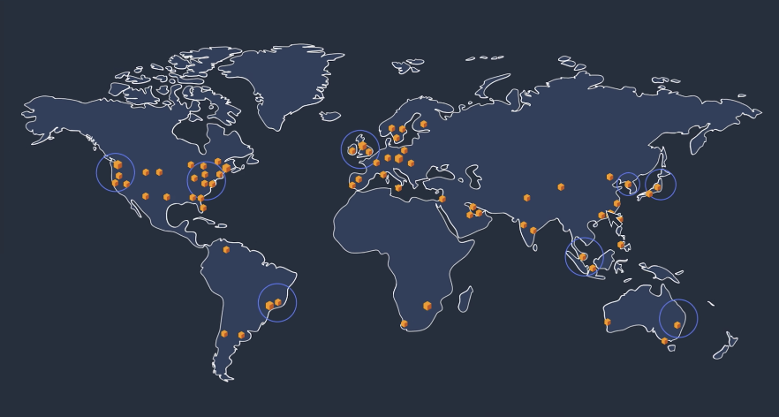
What is Cloud Computing
Cloud computing is the on-demand delivery of IT resources over the Internet with pay-as-you-go pricing
No need for physical data centers or servers
Access on an as-needed basis
Notes:
Basically someone else deals with the data centers and servers
You pay a subscription service fee rather then the cost of ownership - since data is ever changing
Benefits – Agility, Elasticity, Cost saving (use as you need), deploy internationally (servers all over the world reduce latency)
Infrastructure as a service – networking features , computers and data storage space
Platform as a service - removes managing underlying infrastructure
Software as a service – product that is run and managed by service provider
Snowflake

Slide 3
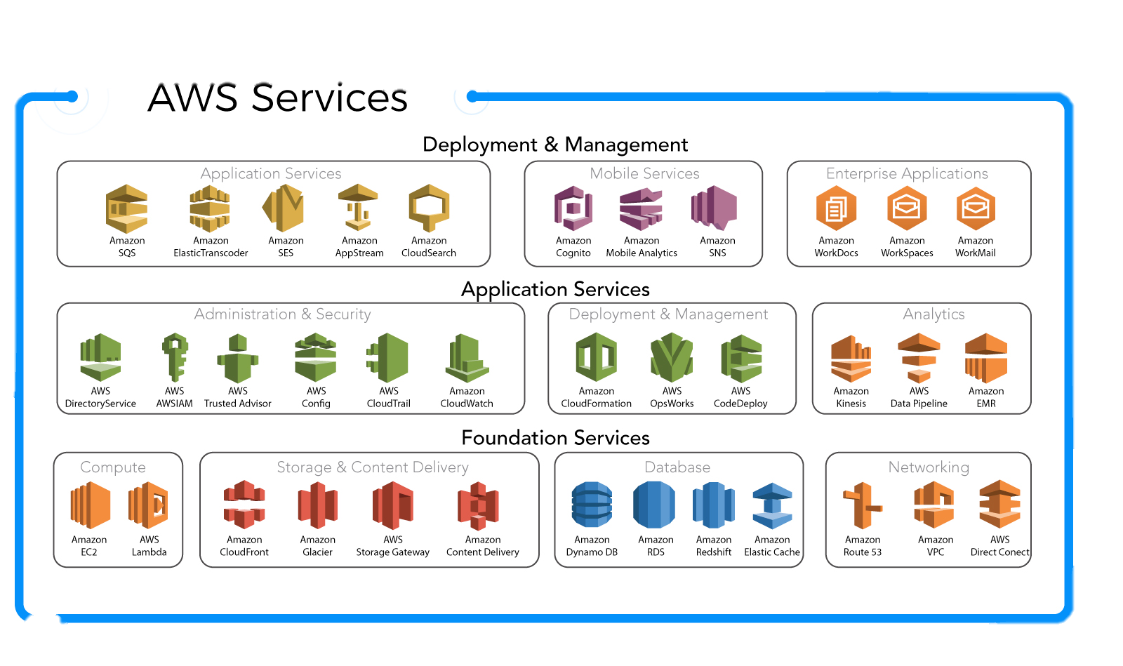
AWS Services

Slide 4
AWS Regions
AWS serves over a million active customers in more than 190 countries
An AWS Region is a physical location in the world where AWS has multiple Availability Zones
AWS provides you with the flexibility to place instances and store data within multiple geographic regions
Notes:
Each Amazon Region is designed to be completely isolated from the other Amazon Regions. This achieves the greatest possible fault tolerance and stability
Each Availability Zone is designed as an independent failure zone. This means that Availability Zones are physically separated within a typical metropolitan region and are located in lower risk flood plains (specific flood zone categorization varies by AWS Region)
In addition to discrete uninterruptable power supply (UPS) and onsite backup generation facilities, they are each fed via different grids from independent utilities to further reduce single points of failure. Availability Zones are all redundantly connected to multiple tier-1 transit providers
eu-west-1, eu-west-2, us-west-1, etc

Slide 5
IAM User and Roles
You can use AWS Identity and Access Management (IAM) roles to grant access to databases among other items
An IAM role is an IAM identity that you can create in your account that has specific permissions but can be assigned to multiple people
You generally have two ways to use a role: interactively in the IAM console, or programmatically with the AWS CLI
complex uses of roles, such as granting access to applications and services, or federated external users, you can call the AssumeRole API
Notes:
IAM users in your account using the IAM console can switch to a role to temporarily use the permissions of the role in the console. The users give up their original permissions and take on the permissions assigned to the role. When the users exit the role, their original permissions are restored.
An application or a service offered by AWS (like Amazon EC2) can assume a role by requesting temporary security credentials for a role with which to make programmatic requests to AWS. You use a role this way so that you don't have to share or maintain long-term security credentials (for example, by creating an IAM user) for each entity that requires access to a resource.
Federated users sign in by using credentials from an identity provider (IdP). AWS then provides temporary credentials to the trusted IdP to pass on to the user for including in subsequent AWS resource requests. Those credentials provide the permissions granted to the assigned role.
Create policy documents to keep track of roles and permissions – you can use Json (config file)

Slide 6
Users, Roles, Groups
USERS: This is the entity that you create in the IAM management console that represents an individual
GROUPS: This is a collection of IAM USERS.
You would use GROUPS to grant/demove permissions for multiple users at the same time (think “HR” or “DEVS” or “ACCOUNTING”)
ROLES: Roles are a set of permissions that can be assumed by USERS or GROUPS (of users) that give access to AWS functions.
Credentials can be temporary
Notes:
It’s been my experience that when you have issues with something in your AWS architecture- be it nodes failing to communicate or something failing to put/pull data from a source it is either permissions or VPC related.
It will be tempting to give max permissions and roles to every “user” that assumes a role to reduce errors. Avoid the temptation to do this
You can set temporary credentials to expire after a set period of time allowing for better security around certain roles

Slide 7
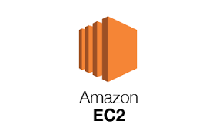
Creating and Managing Virtual Machines with EC2
Amazon Elastic Compute Cloud (Amazon EC2) provides scalable computing capacity in the Amazon Web Services (AWS) cloud
EC2 eliminates your need to invest in hardware up front
Launches instances which are virtual computing environments
Storage volumes for temp data that's deleted when you terminate your instance
known as instance store volumes
Persistent storage volumes for data using Amazon Elastic Block Store (Amazon EBS)
Virtual networks you can create that are logically isolated from the rest of the AWS cloud, and that you can optionally connect to your own network, known as virtual private clouds (VPCs)
Notes:
• Preconfigured templates for your instances, known as Amazon Machine Images (AMIs), that package the bits you need for your server (including the operating system and additional software)
• Various configurations of CPU, memory, storage, and networking capacity for your instances, known as instance types
• Secure login information for your instances using key pairs (AWS stores the public key, and you store the private key in a secure place)
• Multiple physical locations for your resources, such as instances and Amazon EBS volumes, known as Regions and Availability Zones
• A firewall that enables you to specify the protocols, ports, and source IP ranges that can reach your instances using security groups
• Static IPv4 addresses for dynamic cloud computing, known as Elastic IP addresses

Slide 8
Provisioners
Old, ancient system:
Single ”production” server that handled all traffic
Physically existed on site
Physically had to add memory
Newer system:
Virtual machines to handle traffic
Networking multiple machines together
If virtual machine in network breaks, remove it, repair it, return it to network
Newest system:
Create Virtual machines “as needed”
ALL MACHINES MUST BE THE SAME THOUGH (or else responses could change)

Slide 9
Provisioners
Consider the importance of that last line of the last slide!
We need to do three things when we create a machine in the network:
Create the actual machine to match all of the other machines in the network
Put all of the actual dependencies on it (think “apt-get” or “yum install”)
Put the code on it (”git clone”)
And this needs to happen exactly the same way for every new machine that you add to the network- 100% of the time.
ENTER THE PROVISIONER.

Slide 10
Provisioners
Provisioners are part of “Infrastructure as code”.
It’s a piece of code that says (as an example):
CREATE A UBUNTU SERVER
NOW PUT PYTHON, PHP, WORDPRESS ON IT
NOW GIT CLONE MY REPO ONTO IT
NOW OPEN UP PORTS 443 AND 80
NOW JOIN THE CLUSTER
And they “provision” new servers into your cluster as needed
Some examples:
Puppet
Ansible
Chef
Packr

Slide 11
Networking (Virtual Private Cloud)
When creating any sort of architecture you’ll probably want various elements to be able to talk to each other within a network.
INTRAnet versus INTERnet (as an example)
With cloud architecture it’s not uncommon to deploy all elements of a single application into a single network to allow each element to talk to each other.
You can open up the network to the outside world using ports; so you might allow internet traffic into your cloud through port 443 and port 80 BUT…
You would prevent access onto 3306 (port for mysql). NOTHING talks to the Database from outside the cloud!

Slide 12
Networking (Virtual Private Cloud)

Slide 13
Server vs Serverless Architecture
Server | Serverless
Predictive tasks: For tasks that use constant or predictive compute, it may be more cost-effective to use server-based billing | Server management: Because there is no backend infrastructure to be responsible for, liability is reduced and there is no system administration
Testing and debugging: Debugging is less complicated because there is visibility into backend processes and the application is not broken up into separate, smaller functions | Scalability: With a serverless architecture, you don’t have to think twice about provisioning infrastructure because of its ability to automatically scale with traffic volumes
Overall control: The company owns and manages the infrastructure, which provides full control over all aspects of the application | Application flexibility: You can migrate individual application features or partial workloads to run on serverless as on-demand events
Compliance and security: Having full control over the infrastructure allows for full visibility, which may be required for compliance and security standards | Cost: The cost of hiring backend infrastructure engineers goes down, along with operational costs
Legacy applications: Existing applications may not have the flexibility of decoupling individual parts and may be better suited to migrate to a server-based architecture | Startup friendly: The serverless architecture pay-as-you-go model allows you to build an environment nearly for free and ease into the market without dealing with huge bills for minimum traffic
Notes:
So what is the advantage of utilizing a microservices architecture?
The follow the Single Responsibility principle
Resilient/Flexible (you can have a failure in one service without crashing the others)
Highly scalable
Easy to enhance (as you are dealing with less dependencies)
Low impact on other services
Easier to understand
Easier to Test each unit individually
Easier to deploy
Free to choose technology
But there can be disadvantages, including:
Tougher to manage multiple deployments
Integrations between disparate services can have unexpected consequences
Integration testing can be painful
It quickly becomes an administrative nightmare managing the deployments of 10,000 pieces of separate code instead of one monolithic one.

Slide 14
Storage
Cloud storage is the fundamental building block of cloud architecture.
The most basic (and frequently used) form of cloud storage in aws is known as the “S3 bucket”
S3 buckets are really just directories that exist in the cloud
Think of it like your “/Documents” folder or “Downloads” folder
S3 buckets offer a safe, reliable, dependable way to store
your documents on a cloud managed directory that other
parts of AWS can access…
When designing architecture S3 will be fundamental
WRITE DATA TO FILES IN S3!

Slide 15
Cloud Storage System
One of the most common architecture patterns that you’ll see in AWS
involves writing data into S3 buckets as you get it in and only THEN moving it into your database.
This ensures that after each step you have a record of the data somewhere before it is COPIED (“copy” is the SQL command to read a file and sent it up to your preferred cloud SQL database) in case anything ever goes wrong with your SQL db
The data in the S3 buckets (stored as gzipped text files) can then be instantly “ingested” into the SQL database

Slide 16
Cloud Storage System

Slide 17
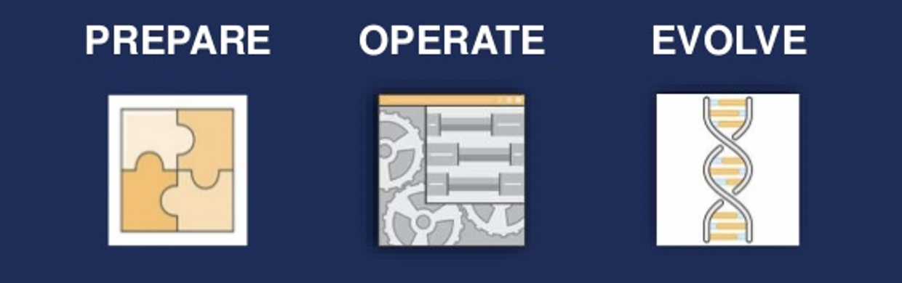
Practical Applications of POE
PREPARE: Use AWS Config- especially the AWS Config RULES to make sure that everything going on with your infrastructure is as intended. We’ll do a quick demo here for that…
OPERATE: We’ll use AWS Cloudwatch for this- which we will get to shortly. Also AWS X-Ray
EVOLVE: AWS Elasticsearch Service is awesome for this type of stuff.

Slide 18
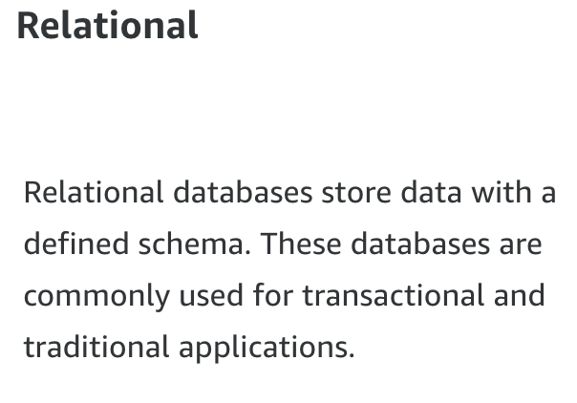
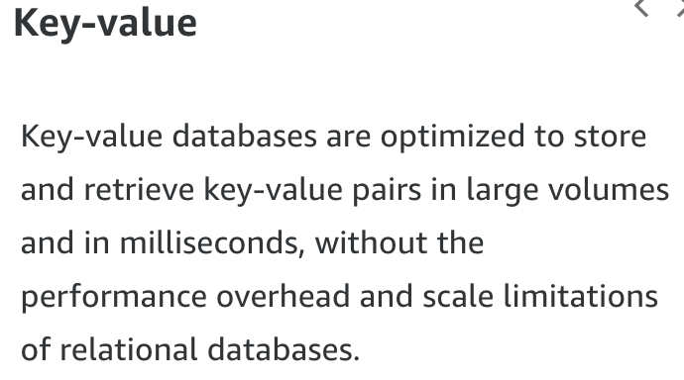
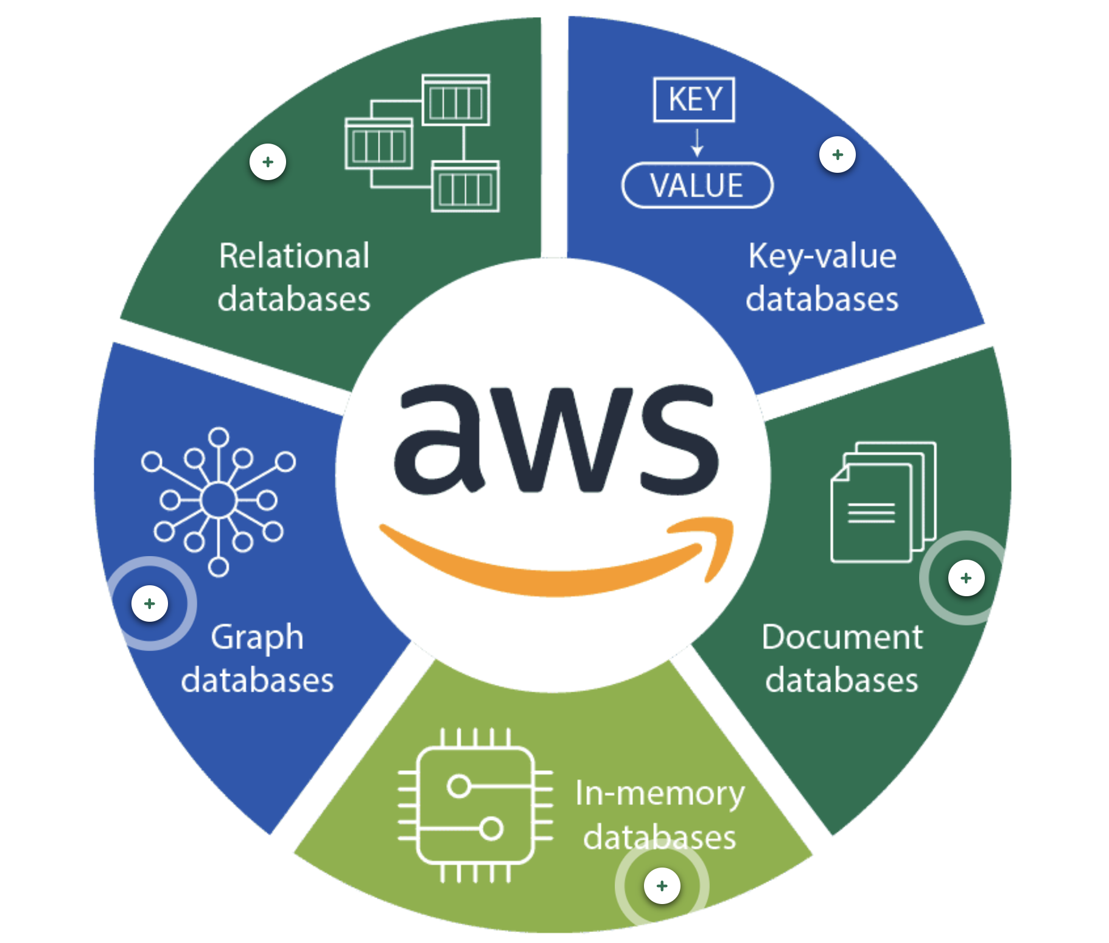
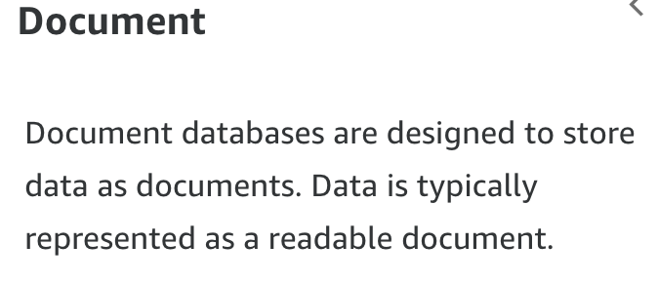
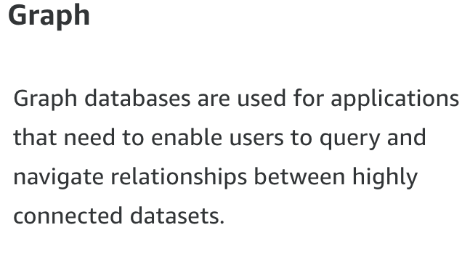
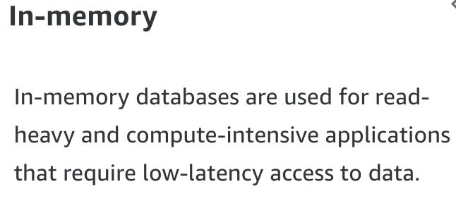
Type of Databases
Notes:
Relational - Aurora – mysql and postgres SQL – use this along with an EC2 instance to ramp up the ability if is slows with huge data sets
KVP – Dynamo DB
Document think mongo DB
Wide Column – High scale industrial apps for equipment maintenance, fleet management, and route optimization
Time series - IoT applications develops and industrial telemetry
Ledger – Systems for record , supply chain, registration, banking transactions

Slide 19

SQL Solutions
Athena – interactive Query service that makes is easy to analyze data directly from Amazon Simple Storage Service (S3 Bucket) with standard SQL. Charges by the number of queries run.
- MPP that allows you to keep the compute and storage separate, while also controlling the cloud services layer.
Redshift – Like Snowflake it too has on-demand pricing. Redshift bundles the compute and storage pricing together and only charging once usage exceeds the allotted seconds. The largest differences are the pricing structures.
BigQuery - Google’s version of the Cloud data warehouse. Again the pricing structure differs with storage being cheaper at a per terabyte than other DWHs.
Notes:
May need to set up Amazon Glue to set up a crawler depending on the format of the data and how it is stored
Athena helps you analyze unstructured, semi-structured, and structured data stored in Amazon S3
Athena integrates with Amazon QuickSight for easy data visualization

Slide 20
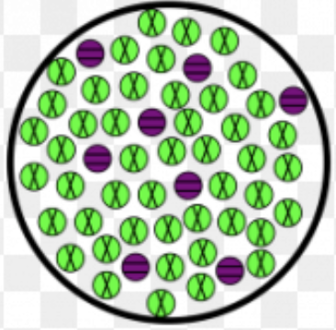
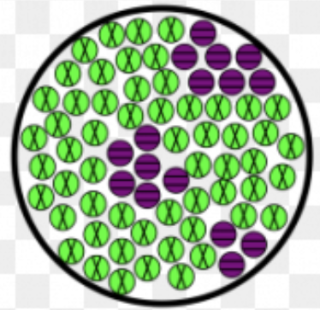
Moving Data in the Cloud
Homogeneous migrations, where you migrate between same database engines, may require the use of native database tools to migrate database elements
Heterogenous migrations, where you migrate between different database engines, require the use of the Schema Conversion Tool to first translate your database schema to the new platform
Notes:
Identifies the issues, limitations, and actions for the schema conversion
Generates the target schema scripts, including foreign keys and constraints
Converts code such as procedures and views from source to target and applies the code on the target.

Slide 21
Transforming Data
In any ETL process we’ll want to transform data en route to the database.
As data is flowing through the ETL AWS has several options for transformations, including:
Lambdas:
Every time you get a piece of data into your AWS system a LAMBDA will run a single, small piece of code that will transform the structure of that data before passing it on to the next “step” in your ETL process
Lambdas do NOT need to live on servers to run- AWS runs them virtually. You do not need to worry about a server.
IN-STREAM transformations:
With Streaming (read- EXTREMELY FAST MOVING) data AWS can actually have the “pipeline” that the data is going through do some transformation before sending it along to the next step in the process

Slide 22
Managing Infrastructure (Terraform)
Remember the discussion around “provisioners”?
Remember how we can write code that will “create a virtual machine and do various things to prepare it to join the cluster”?
Modern AWS infrastructure can all be done in code…basically the same as a provisioner…
So for example if we want a lambda to be created and three s3 buckets we write that in code, run it, and those are created
We then download code into the lambda and run it

Slide 23
Managing Infrastructure (Terraform)
Terraform is basically a way of putting your entire infrastructure into CODE form and making all changes and deployments through that code.
Want a new Virtual Private Cloud? Write it in Terraform
Want a new Lambda? Write it in Terraform
Terraform is a provisioner that works for Azure, GCloud AND AWS and ensures that your infrastructure can be re-deployed quickly in case of emergency!

Slide 24
Traditional vs Cloud Data Warehousing
The biggest difference between Traditional and Cloud Data Warehousing has to do with the fundamental impermanence of the infrastructure.
With traditional data warehousing you create, for example, a MYSQL database that must remain in pristine condition
We need to make sure that data going in does not crash the system
All data needs to be permanent and cleaned
In cloud infrastructure you can destroy and re-create databases at will (again- think of wizards provisioning things out of nowhere)
Instead of bug hunting- in cloud infrastructure we just destroy and recreate

Slide 25
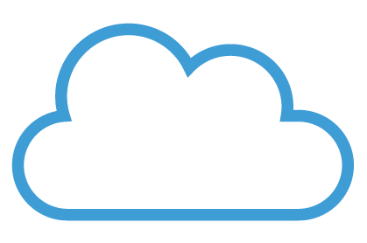
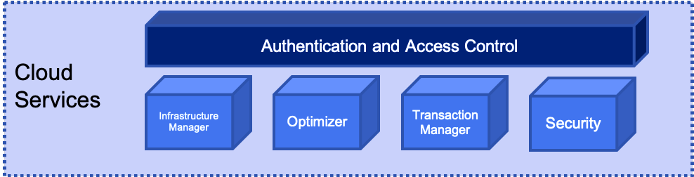
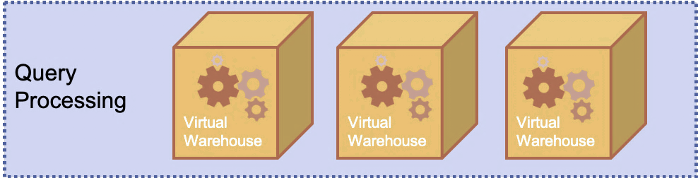
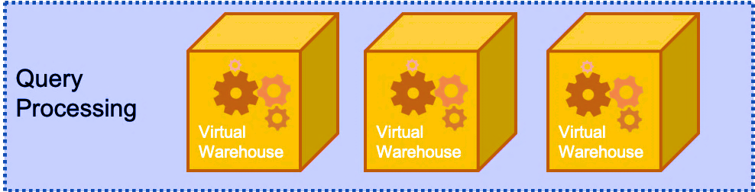
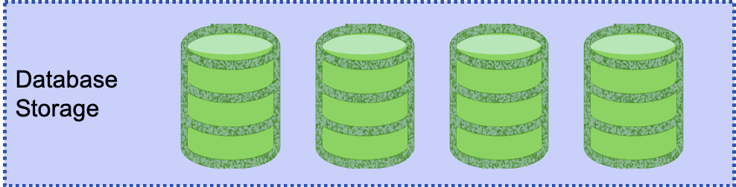
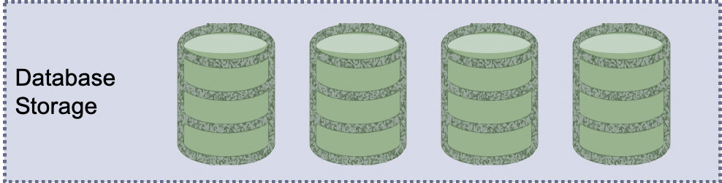
Snowflake is a hybrid of Shared Nothing and Disk
So how does Snowflake address these shortcomings?
Snowflake is Elastic!
Notes:
The idea here is that by using the cloud based infrastructure SNOWFLAKE can essentially throw resources at the management of shared-nothing infrastructure indefinitely.
This is because Snowflake is elastic in nature- it will expand as resources are required and contract when not required.
This addresses both the high compute requirements of Shared Nothing AND the high-cost requirements of creating “workers”

Slide 26
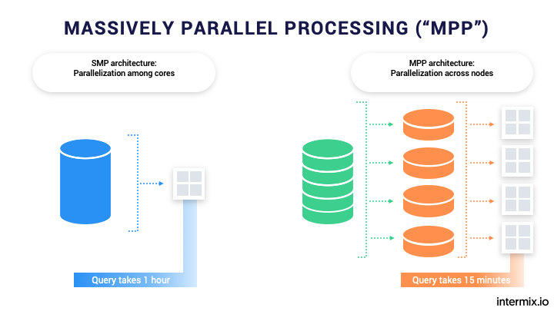
Massive Parallel Processing
Snowflake is a shared-nothing or massive parallel processing system.
Imagine if you will, for a minute, a series of workers, each of whom have their own memory, resources, and processors assigned to a task.
We can split the task among these workers thereby speeding up the task immeasurably.
“MPP is the coordinated processing of a program by multiple processors that work on different parts of the program, with each processor using its own operating system and memory”

Slide 27
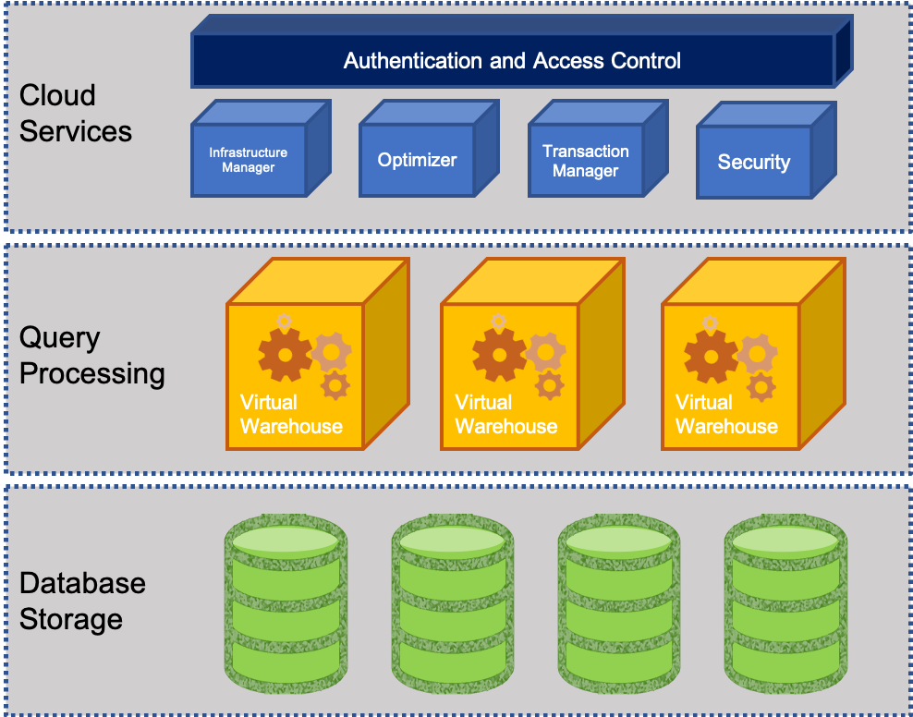
What does Snowflake offer?
Let’s divide data warehouses into three parts:
Storage: for storing data and
Computing: which is what allows us to do all the things we do in structured SQL databases
Services: Which are some of the things like pipelines, etc.
Snowflake offers us the opportunity to independently scale the storage, services, and the computing. Why is this important?

Slide 28
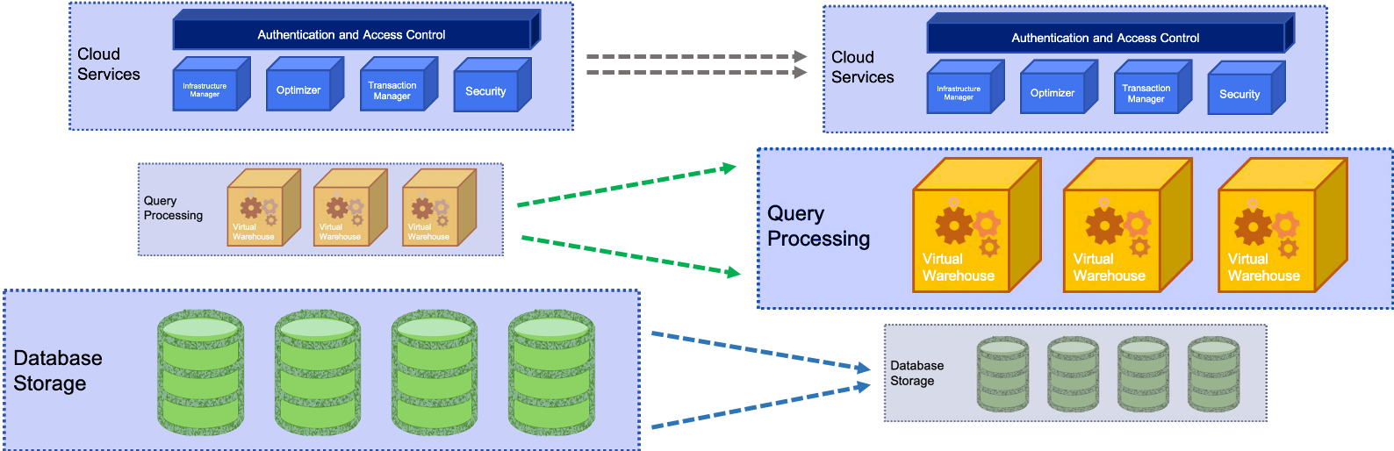
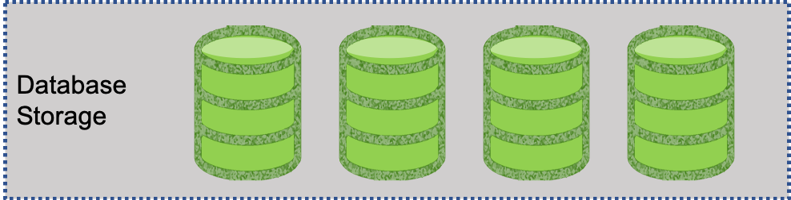
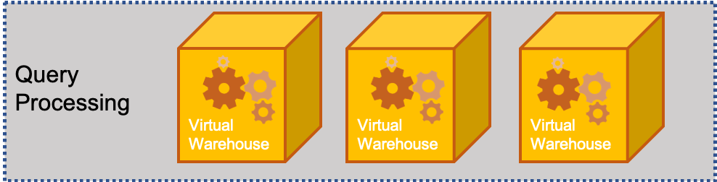
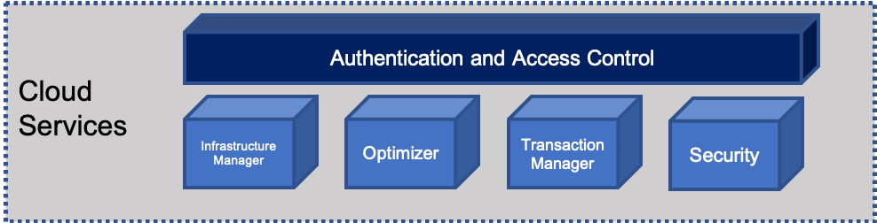
Snowflake Elasticity
Snowflake has a novel concept to deal with elasticity:
This means that we can deal with the DATA STORAGE, COMPUTE and USERS (Services) layer without effecting the other ones
DATA
Services
Compute
Notes:
By isolating each layer they can expand and contract independently of each other.
This means that we can deal with the DATA STORAGE, COMPUTE and USERS (Services) layer without effecting the other ones.
Let’s go into each of these
DATA - The amount of data stored can be increased or decreased at any time.
- Data and compute decoupled – is determined independently of the volume of data in the system
- store data at a very low cost because no compute resources are required to store data in the database
COMPUTE – these resources that are being used for query processing can also be scaled up or down depending on the intensity of the workload on the system changes.
- remember - storage and compute are decoupled,
- data is dynamically distributed
- changing compute resources does not require reshuffling the data
- Compute resources can be changed on-the-fly, without disruption.
SERVICES – with other systems as more users come on the the resources are strained and everything becomes much slower
- other system solution is to create a new datamart
- extra management burden
- replicating and/or migrating data across systems
- Snowflake can scale to support more users and workloads without performance impact because multiple virtual warehouses can be deployed on-demand, all with access to the same data.

Slide 29

Snowflake Automation
Data distribution:
Managed automatically by Snowflake based on usage.
Snowflake automatically manages how data is distributed in the virtual warehouse
Other systems rely on a static partitioning scheme based on a distribution algorithm or key chosen by the user at load time
Data is automatically redistributed based on usage to minimize data shuffling and maximize performance.
Loading Data:
Complex ETL data pipelines are no longer needed to prepare data for loading. Snowflake natively supports and optimizes diverse data, both structured and semi-structured, while making that data accessible via SQL.

Slide 30

Confused? ASK QUESTIONS

Slide 31
Break & Lab2
Notes:
Take a data set how would you set up the Schemas

